Slide 1
Color Analysis
Categorize person into 1 of 12 CPs

Slide 2
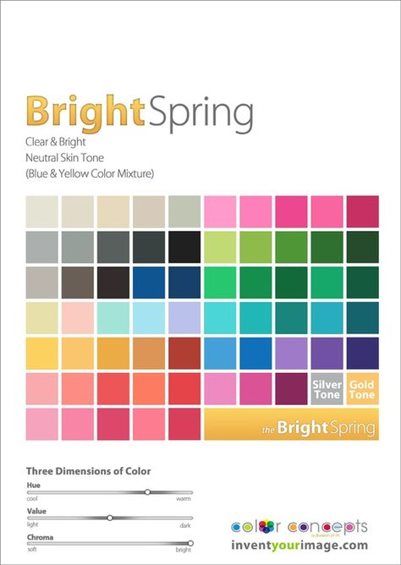
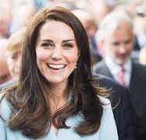
Which color palette fits her best?
Input: profile image
Segmentation: Background/Foreground, clothes object (transparent), so head is isolated
Display: 16 x same profile image (4, 3) with colors from 16 different color palettes
Triage 1: one go has 2 x same profile image with questions – if question is unclear ability to skip the question, 3 rounds of goes [(is she dark or light?) , (is she cold or warm? Background into orange/gold or blue/silver color for easier assessment), (is she muted or clear?) ], final go displays the color palette derived from the questionnaire
Triage 2 (without question): show cps in 2x same profile image for comparison, 3 rounds of goes (which CP fits her complexion better? ), final go is the winner CP
Triage 3: show self-made (not seasonal!) cps in 2 x same profile image for comparison, 3 rounds of goes (bright cp vs. muted cp), final go will determine season with winner CP

Slide 3
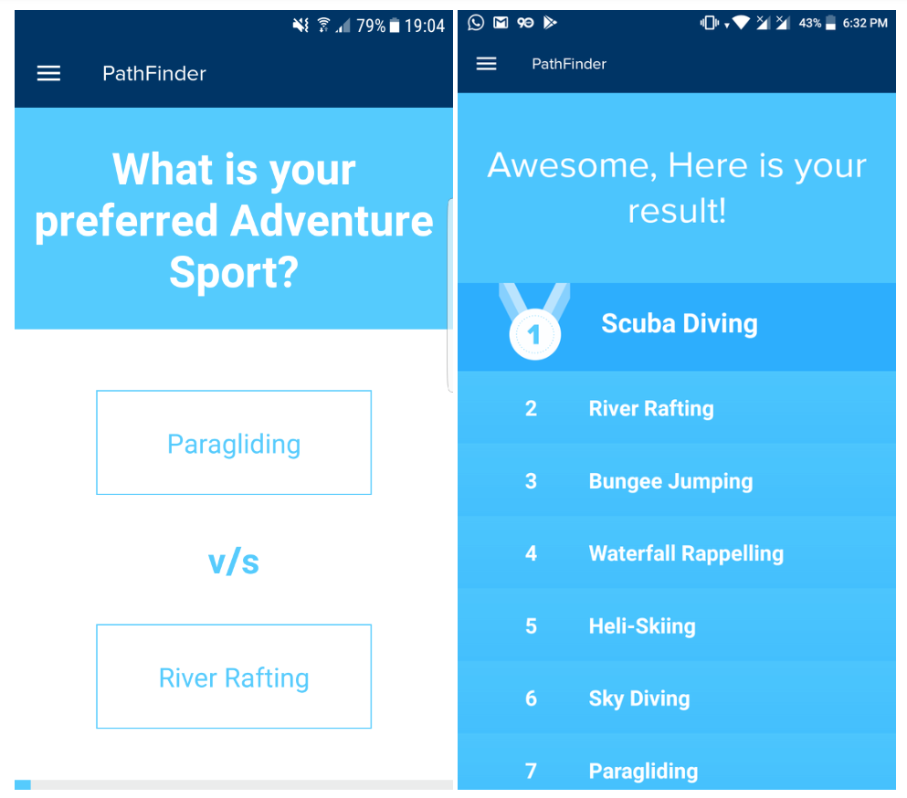
Python Algorithms
Sort Colors in CP: Done
Sort by HSV (do HSL)
Binary Palette Sort Algorithm
https://www.makeartwithpython.com/blog/visualizing-sort-algorithms-in-python/
Triage Tool: k.o.-system / single-elimination on tournament / ranking system / rankings from pairwise comparisons for decision-making, decision hierarchy to handle / priority calculator: Done
https://stackoverflow.com/questions/20375954/how-can-i-rank-images-by-only-comparing-them-to-each-other
https://www.questionpro.com/tour/pairwise-ranking-and-comparison.html
https://bpmsg.com/ahp-online-calculator/

Slide 4
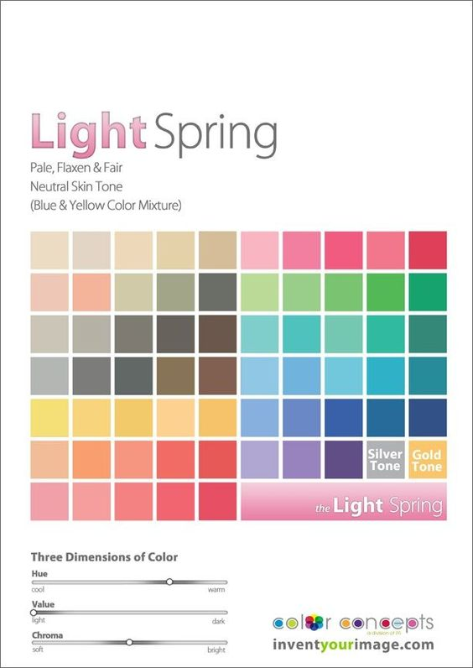
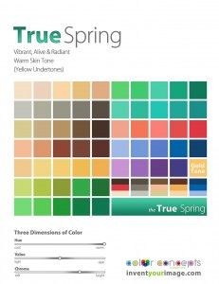
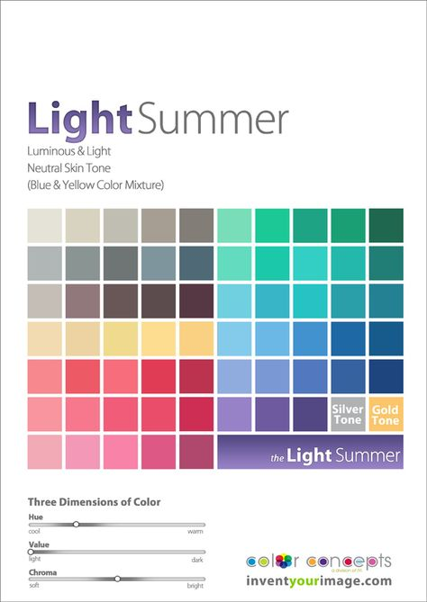
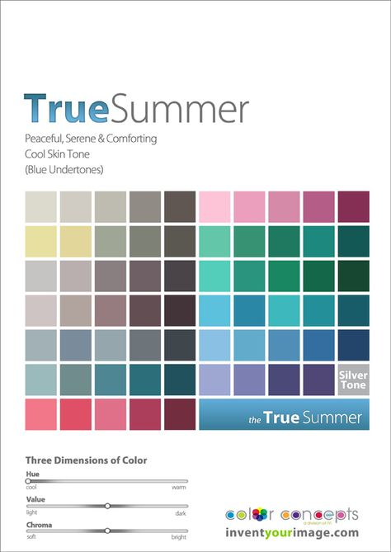
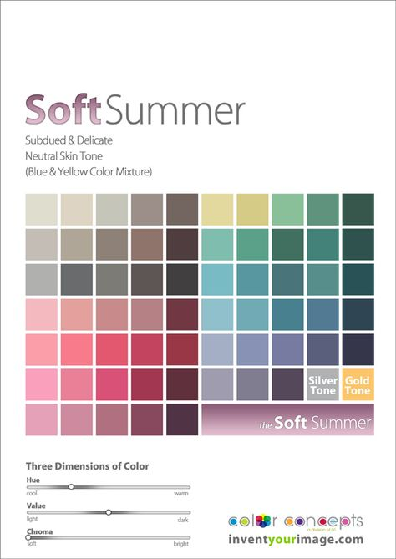
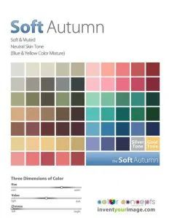
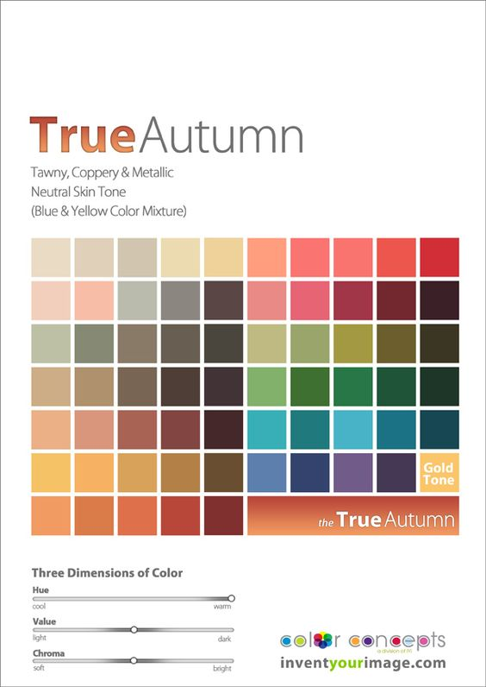
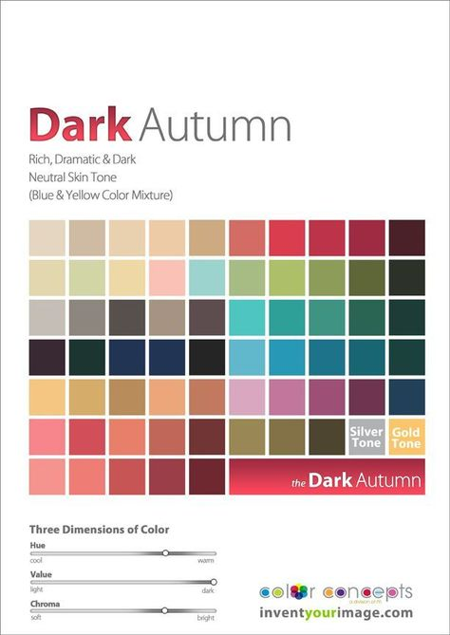
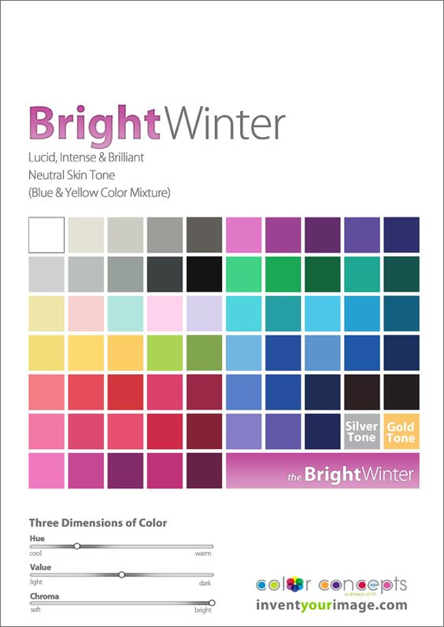
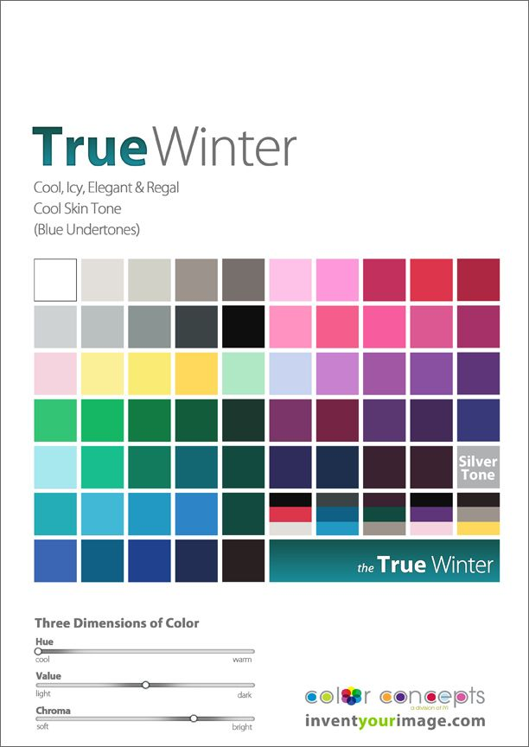
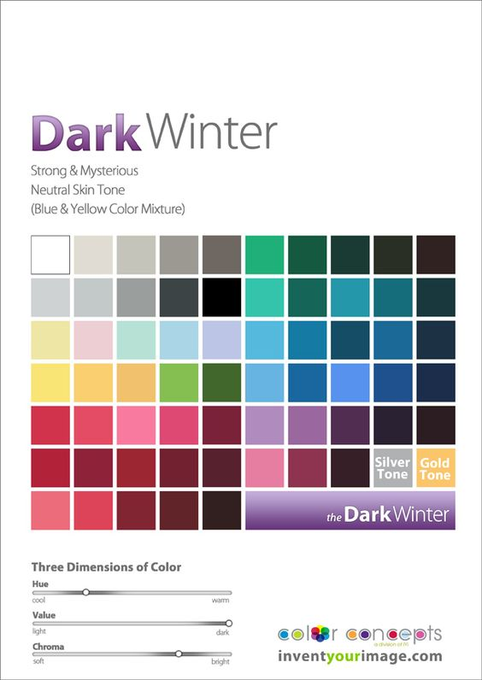
1 Color
Segment background and color it white
Segment clothes
Color in clothes with one color from CP
70 possibilities per CP
For triage take colors from different CPs
Segment clothes and color it white
Segment background
Color in clothes and background with one color from CP (need to sort colors in CP)
70 possibilities per CP
For triage take colors from different CPs

Slide 5
10 Colors
Make ring of 10 points around person
Color in ring of points with similar colors from CP
(need to sort colors in CP)
3. 7 possibilities per CP
Make 10 patches below person
Color in color patches with similar colors from CP
(need to sort colors in CP)
3. 7 possibilities per CP

Slide 6
30 Colors
Make multiple rings of 10 points around person
Color in ring of points with similar colors from CP
(need to sort colors in CP)
3. 2 possibilities per CP

Slide 7
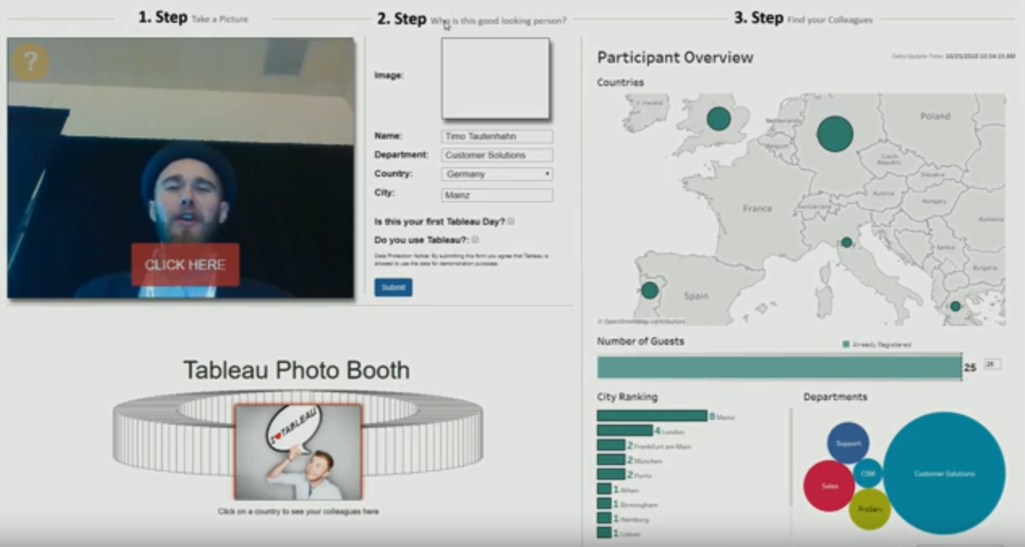
GUI
Login account
Purchase tool
classify picture into your palette /
Automatic classification of picture into palette
Get a T-shirt in chosen color
Take a picture /
Upload a picture
View colors from your palette
Pick a color
From palette
Shop your T-shirt

Slide 8
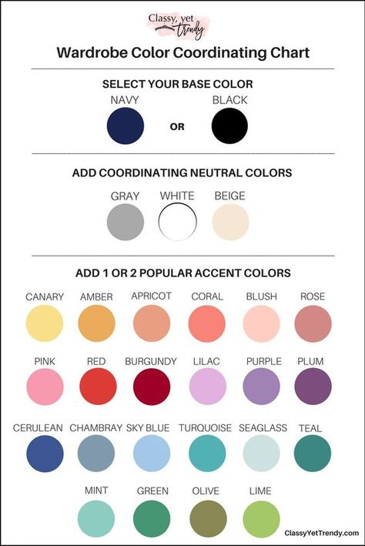

Slide 9
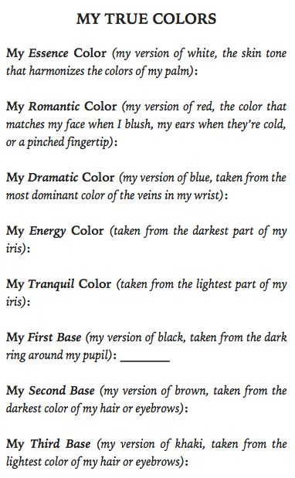
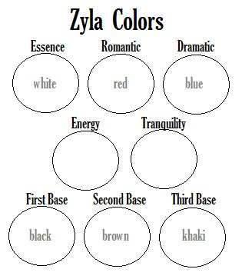

Slide 10
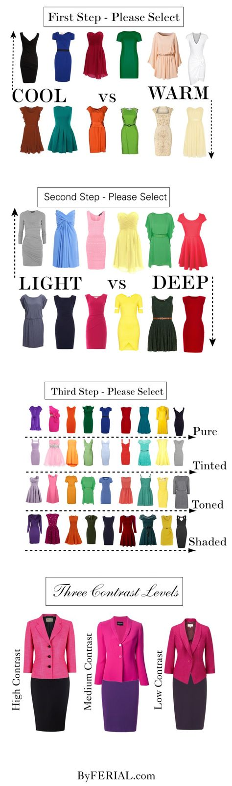

Slide 11
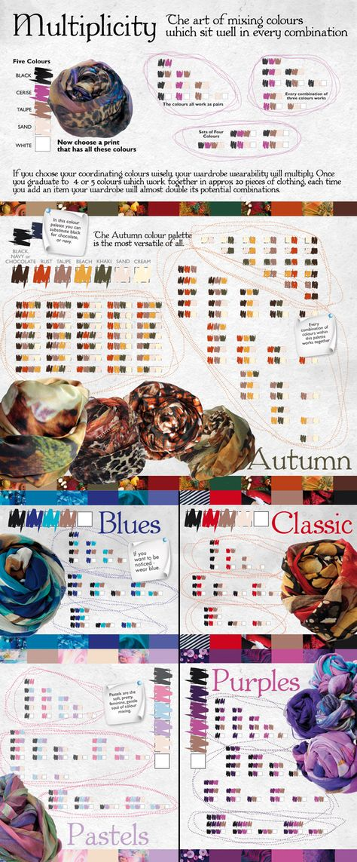
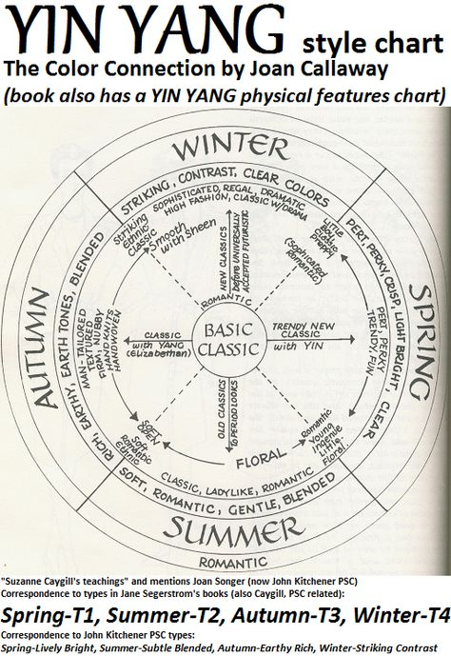
Mixing Colors

Slide 12
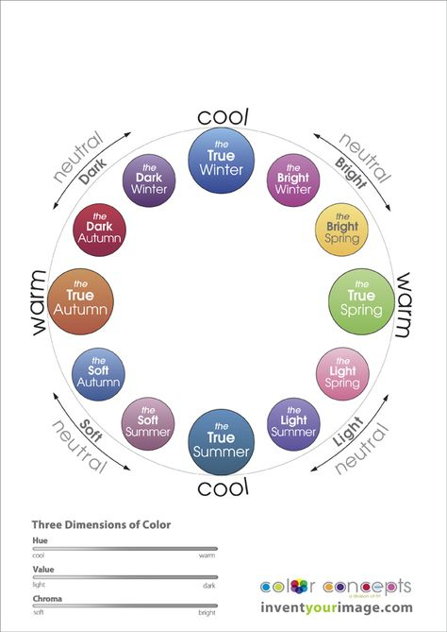
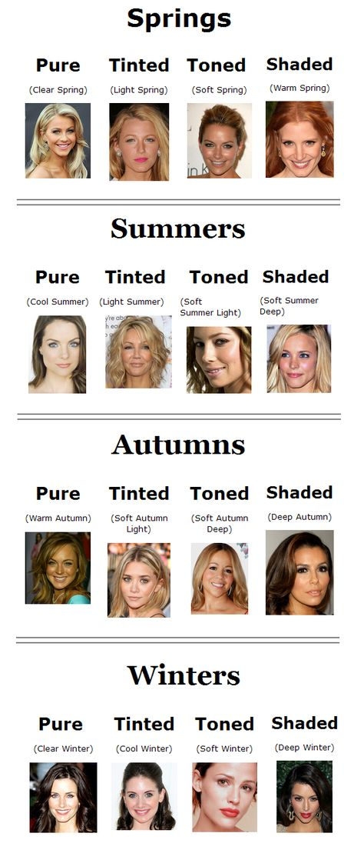
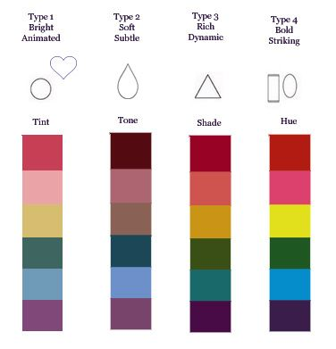

Slide 13
User Story
User uploads or drag/drops a celeb image (or any category of image, such as interior design? ), name image
Goes through the image priority calculatory for 12 cps:’image1’, ‘CP1’ or ‘image2’, ‘CP2’?
Saves top 1 categorization of celeb image to wall: columns=( ‘ image’, ‘CP’ ), image searchable through image name

